Slide 1
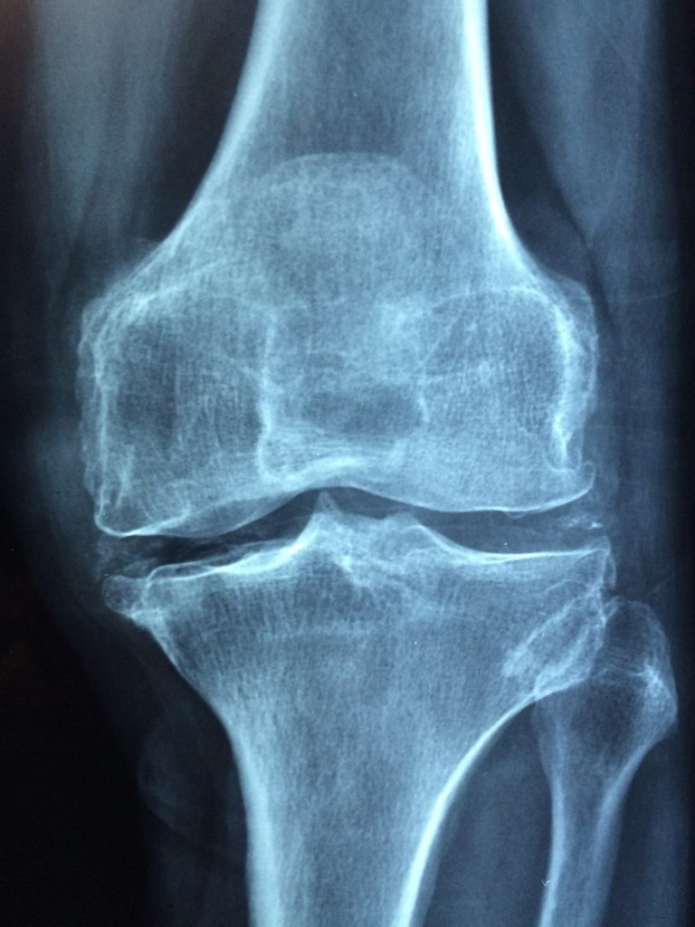
Deep Learning model for Knee joint disease analysis
Under supervision of
Dr. Ahmed ezz
Eng. Ahmed eisa

Slide 2
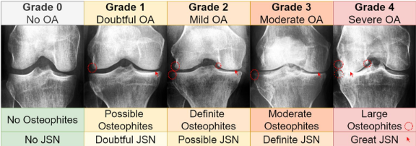
Submitted By
Hisham said
Rodina moawad
Mahmoud hamed
Nour el deen
Evana boles
Yasmin ashraf
Hager said

Slide 3
Introduction
-Brief overview of the knee joint and common diseases affecting it:
the knee joint is a complex structure that plays a crucial role in movement and weight-bearing.
Common diseases affecting the knee joint include osteoarthritis, rheumatoid, meniscus tears, ligament injuries and our main concern in the project osteoporosis.
-Importance of accurate disease analysis and diagnosis:
early and accurate diagnosis of knee joint diseases is essential for effective treatment and improved patient outcomes. Advanced analytical models can aid in diagnosing and predicting disease progression.“

Slide 4





Doctors’ Opinions
Big Thank to DR. Ahmed Tarek(professor of Bones surgery)
the diagnoses does not only depend on the x-ray but there are also other important attribute such as age, gender and medical history and This was the opinion of the orthopedic doctor we consulted

Slide 5
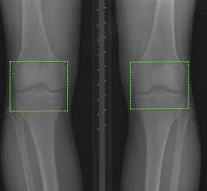
Project objectives
- Goals of the knee joint disease analysis model:
The primary goal is to develop a robust model that can accurately
diagnose knee joint diseases using medical imaging and clinical data.
-Expected outcomes and impact:
"We aim to enhance diagnostic accuracy, reduce misdiagnosis rates, and provide a tool for healthcare professionals to better manage patient care."
Of course, this will be a tool for doctors to use, meaning that the first and last opinion is for the doctor, and the patient is not permitted to diagnose himself.

Slide 6
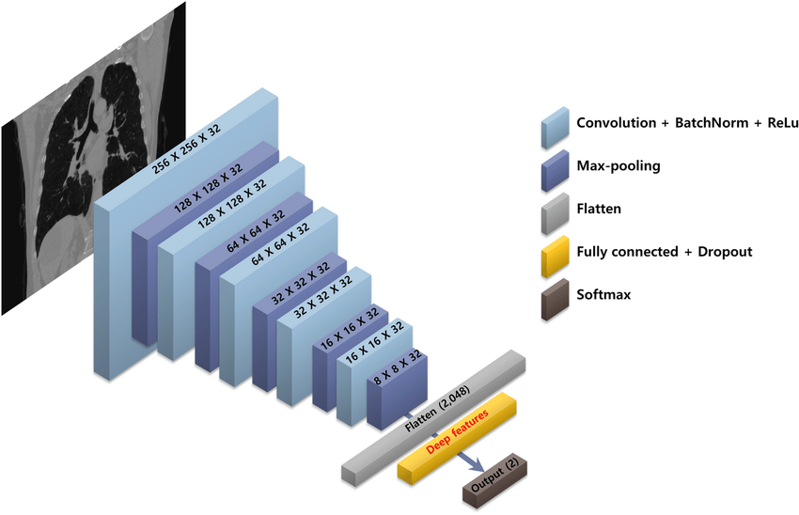
CNN
Definition: Convolutional Neural Networks (CNNs) are a class of deep neural networks
Structure: Consists of multiple layers including convolutional layers, pooling layers, and fully connected layers.
Key Feature: CNNs automatically detect important features in images such as edges, textures, and patterns, making them highly effective for image recognition tasks.

Slide 7
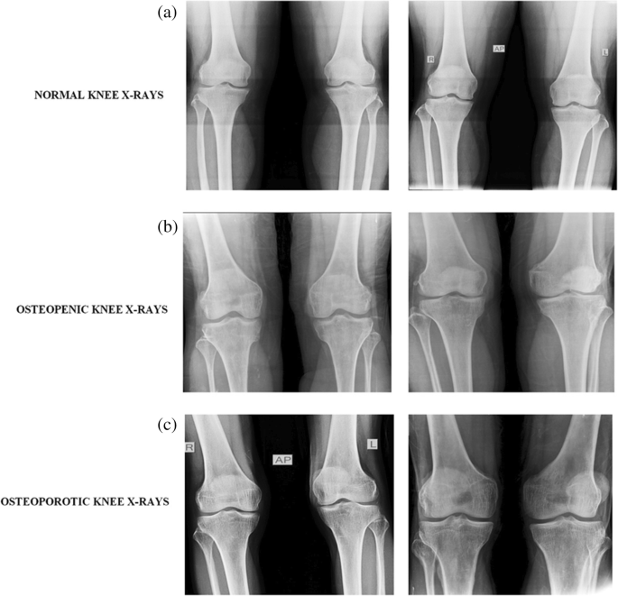
Applications of CNNs
Image Recognition: Used in systems like facial recognition, object detection, and medical image analysis.
Computer Vision: Applications include autonomous driving, where CNNs help in recognizing road signs, pedestrians, and other vehicles.
Natural Language Processing (NLP): Employed in tasks like text classification and sentiment analysis by recognizing patterns in textual data.
Robotics: Helps robots understand their environment through visual inputs.

Slide 8




Key Components of CNNs
Layers of CNNs:
Convolutional Layers
Pooling Layers
Fully Connected Layers
Activation Functions

Slide 9


Convolutional Layer
Function:
Apply convolution operations to the input image using a set of filters/kernels.
Key Concepts:
Filters/Kernels
Stride
Padding

Slide 10
Pooling Layer
Function:
Reduce the spatial dimensions (width and height) of the input volume.
Types:
Max Pooling
Average Pooling
Benefits:
Reduces computation and helps prevent overfitting.

Slide 11
Activation Functions
Purpose:
Introduce non-linearity into the model.
Common Functions
ReLU (Rectified Linear Unit)
Sigmoid
Tanh

Slide 12
Methodology
We used CNN which is a type of artificial neural network used primarily for image recognition and processing, due to its ability to recognize patterns in images.
Data Preparation & Preprocessing
Histogram Viewing
Data Splitting
Loading The model
Training and Testing Process
Model Evaluation
Heat map

Slide 13
Data collection
Data collection is the primary step in developing an efficient transfer learning model
d without a high-quality training dataset, high-performing models can also generate low predictive accuracy. One of the largest sources for collecting high-quality data is Kaggle where we had out data set
As we use two different datasets for each methodology
CNN
Train-set | 5778__70%
Test-set | 1656__10%
Validation-set | 826__20%
Total | 8260 __100%
Data set of Transfer learning | It wasn’t divided and trained with 80% total 1650 image

Slide 14
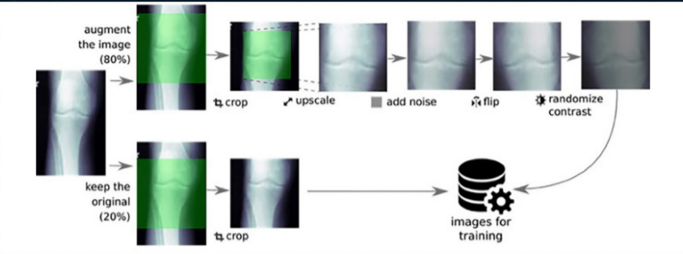
Data preparation
Before feeding the images into the deep
Learning model, preprocessing steps are applied
To ensure consistency, quality, and compatibility
With the model architecture
In transfer learning model We put the data to be preprocessed by using crop, resize and gray scale to detect the ROl and help the model train with high accuracy and the used library here is OpenCV

Slide 15
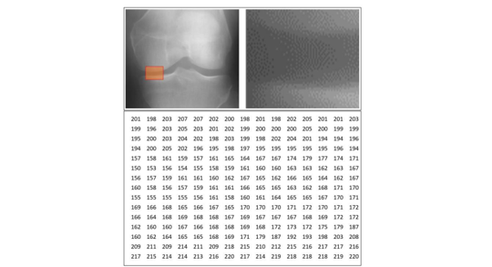
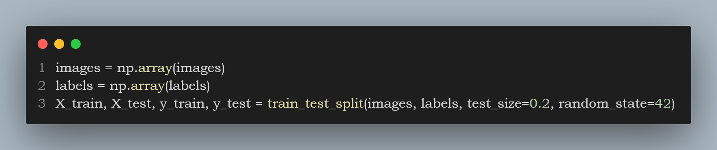
Data preparation
Image Loading:
Resizing and ROI Extraction:
Resize images to a specific dimension 98X98
Extract a specific region from the image.
Normalization:
Convert image pixel values to float32 and normalize to the range [-1, 1].
Data Augmentation:
Apply transformations such as horizontal flips to generate more data.
And in our previous experiments in CNN we tried another technique OTSU threshold

Slide 16
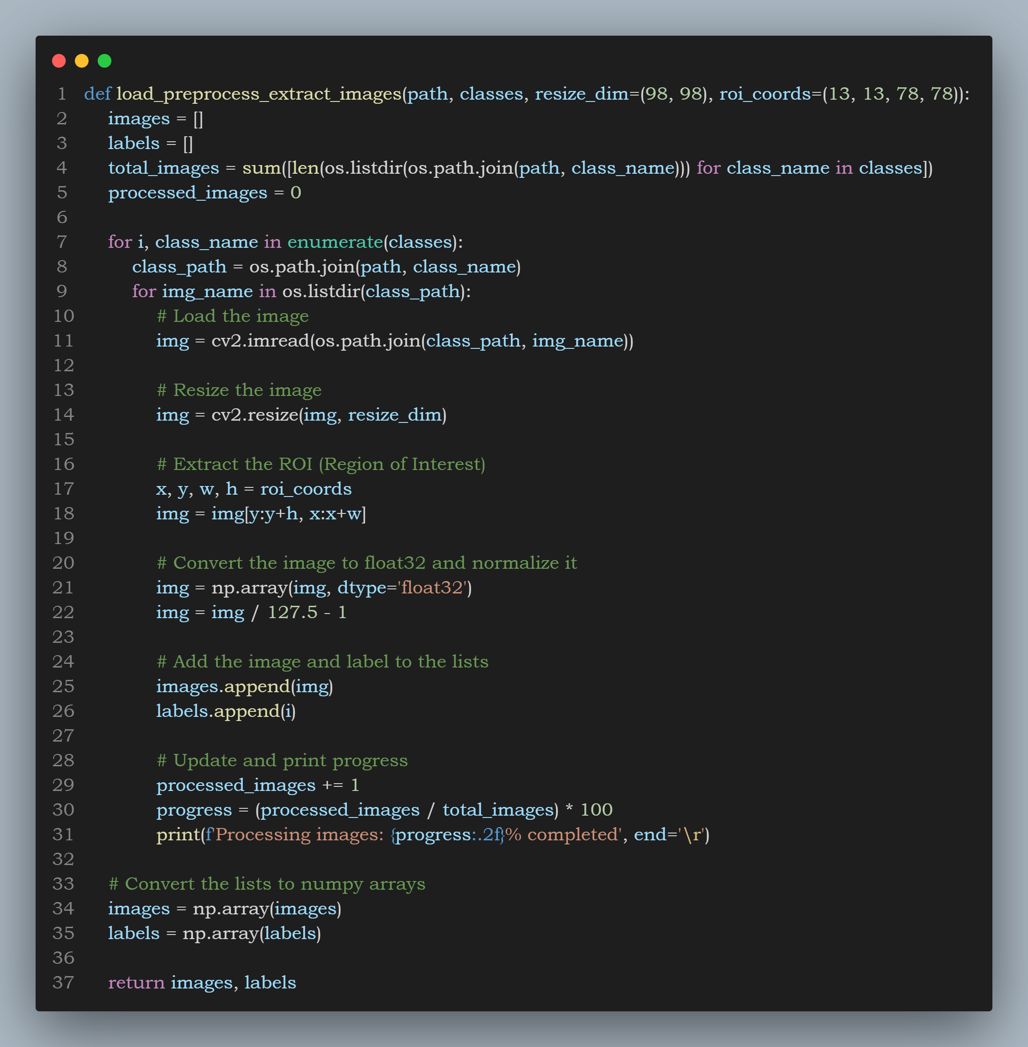
Data preprocessing
loads images from specified classes, resizes them, and extracts a defined region of interest (ROI).
It then normalizes these images and appends them to a list along with their corresponding labels, while displaying the processing progress. Finally, it converts the lists of images and labels into NumPy arrays for further use.

Slide 17

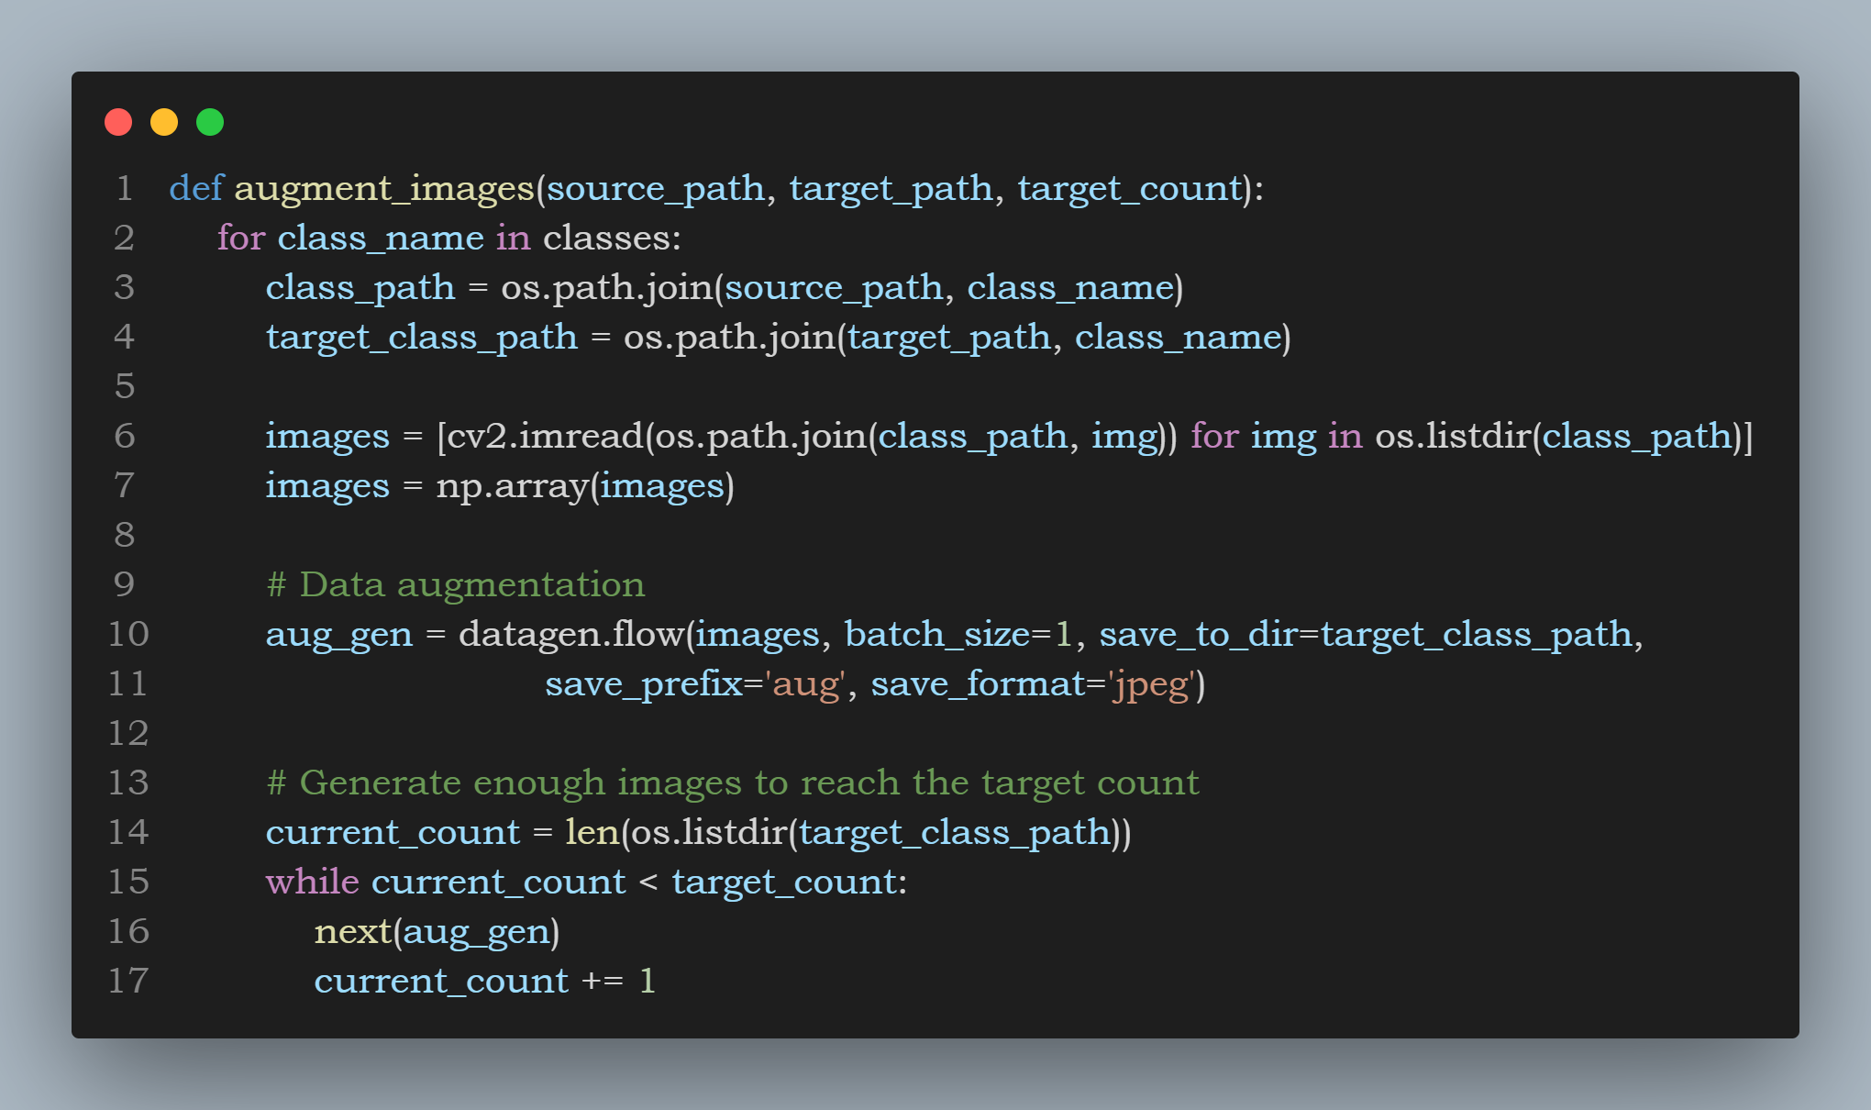
DATA AUGMENTATION
Data augmentation helps improve the robustness and performance of the model by generating variations of the training images.

Slide 18
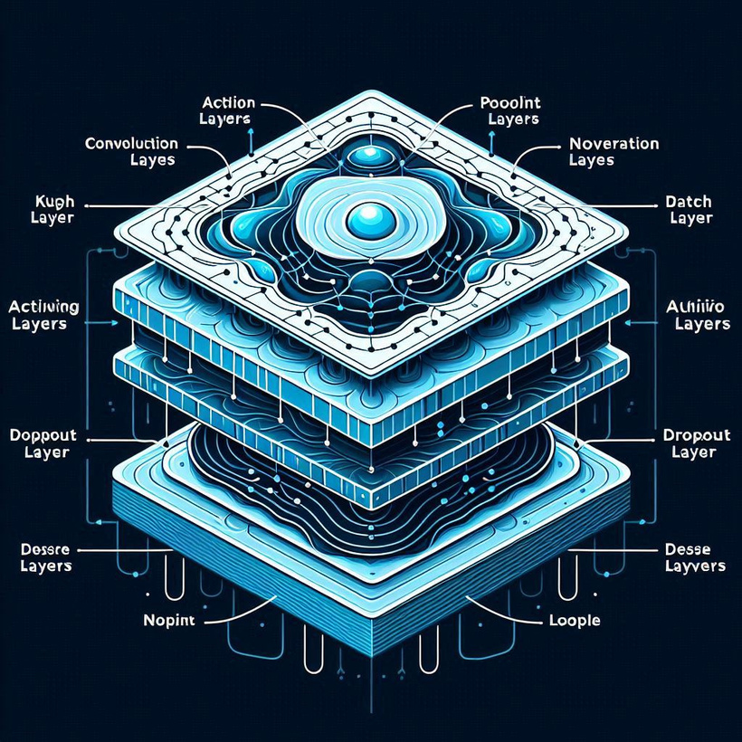
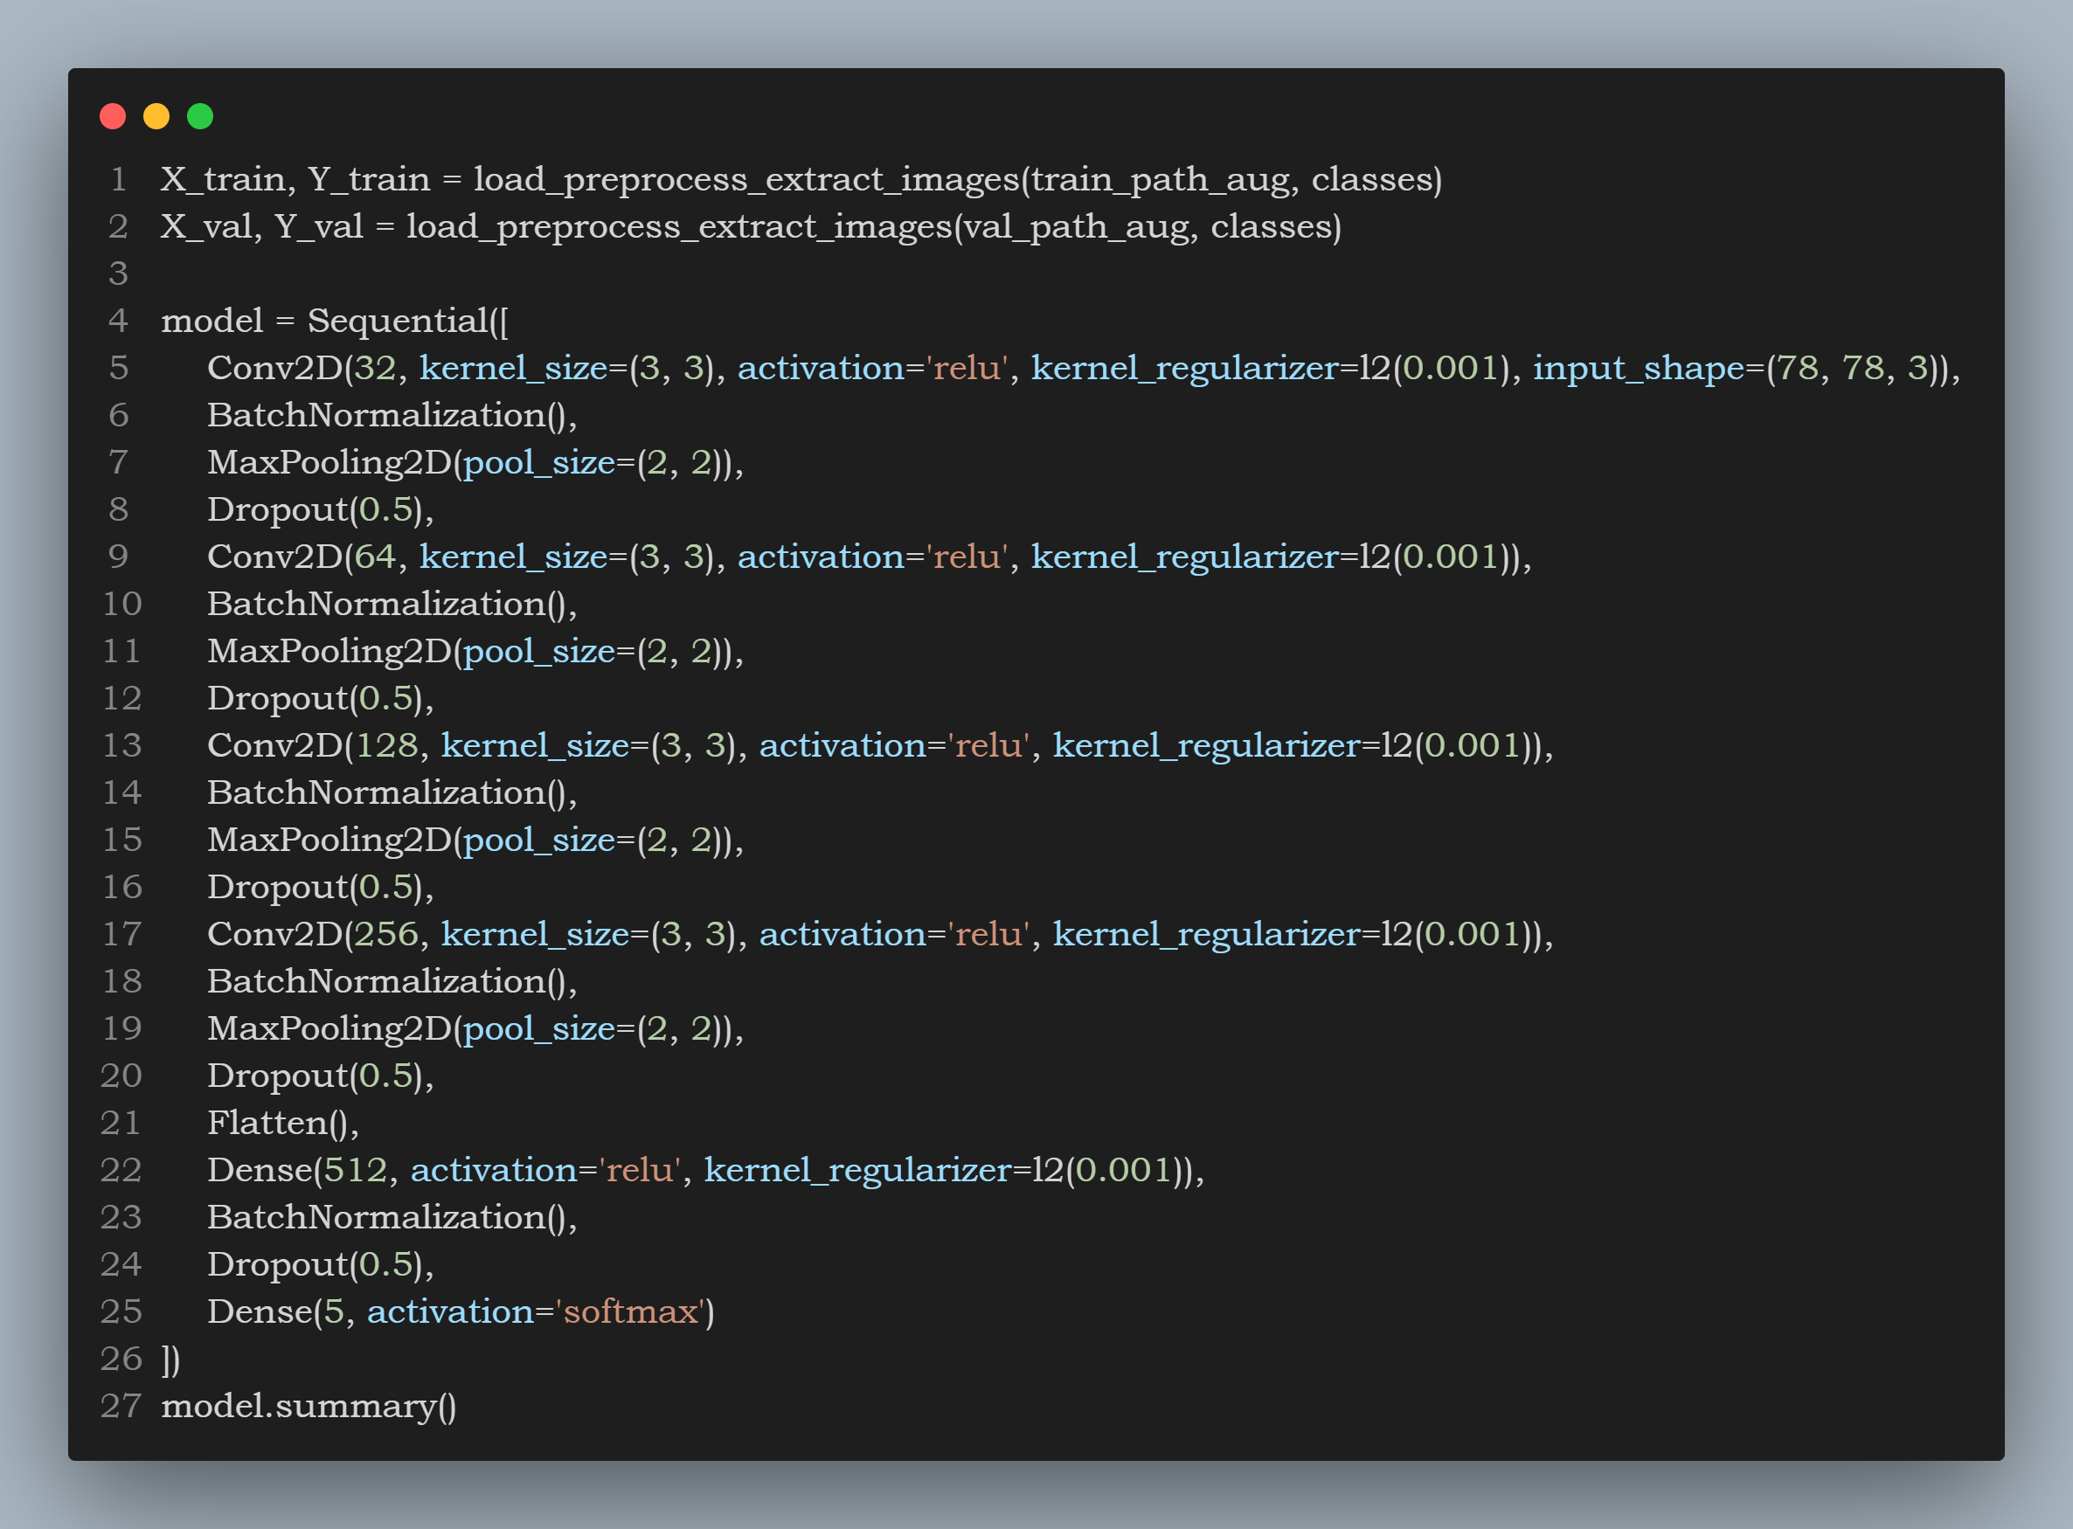
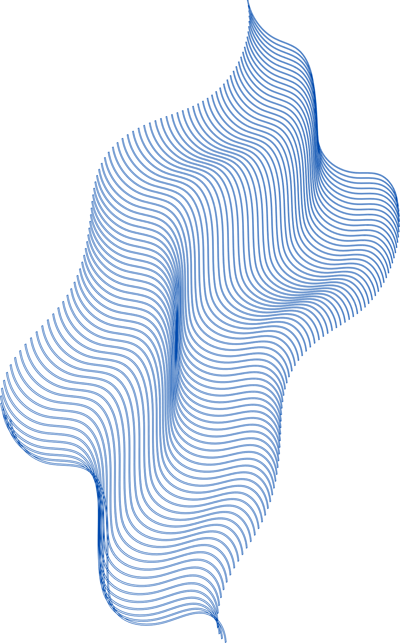
MODEL ARCHITECTURE
Convolutional layers
Activation functions
Pooling layers
Batch normalization
Dropout layers
Dense layers
Softmax activation

Slide 19
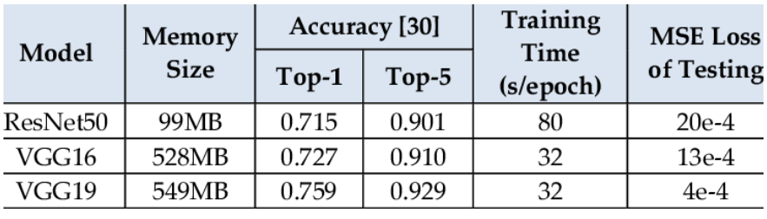
Model training
In the beginning of work, we built our own model and accuracy was 28% then we tried VGG 16 ,VGG 19 , resnet-50 , inception and finally CNN
Our purpose was to learn the architecture of models
CNN Results | 78%
Resnet-50 | 43%
VGG19 | 67%

Slide 20
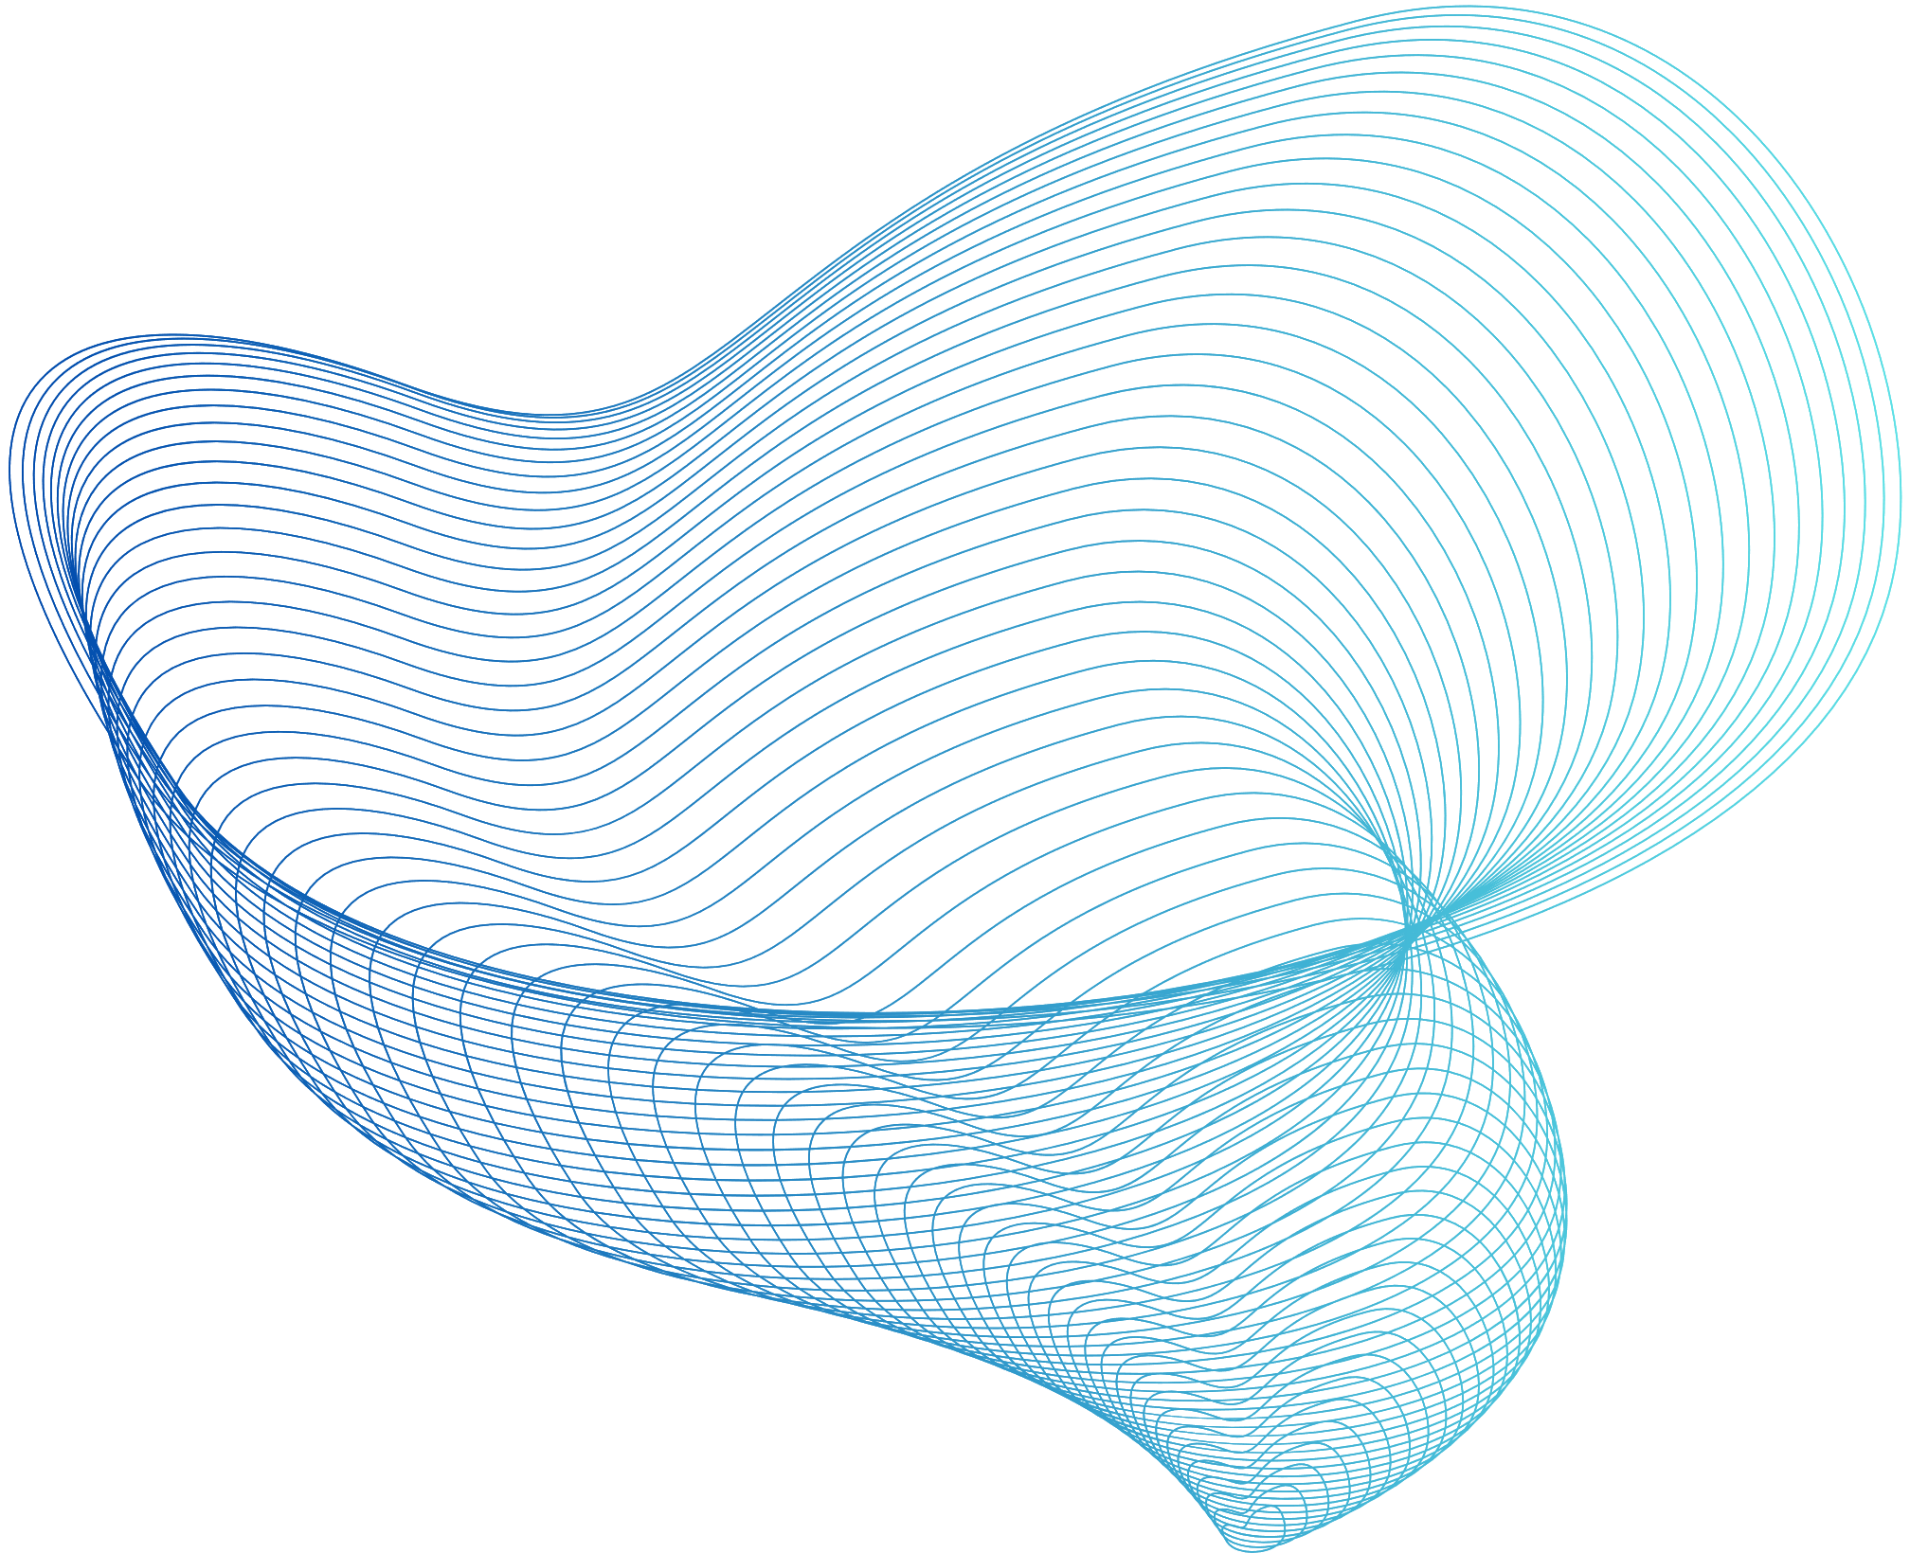
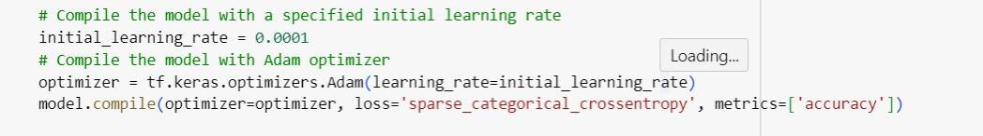
TRAINING PROCESS
Overview of training methodology
Forward and backward propagation
Optimization algorithms (e.g., Adam, RMSprop)
Key parameters:
Number of epochs
Batch size
Learning rate

Slide 21
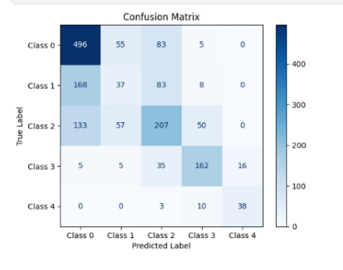
A confusion matrix is a fundamental tool. It allows us to evaluate the performance of a classification model by presenting a comprehensive summary
Confusion matrix

Slide 22
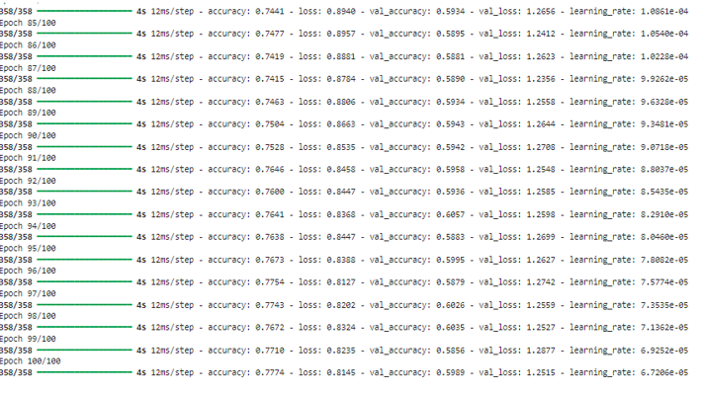
Results

Slide 23
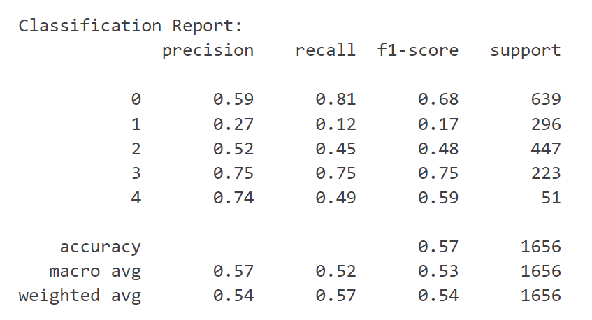
Evaluation Performance Metrics
Accuracy:
Precision:
Q+R
______
Q
Recall (Sensitivity):
P
____
S+T
F1 Score:
2*P*R
_______
P+R

Slide 24
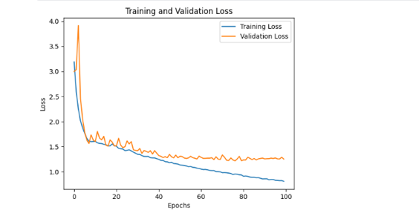
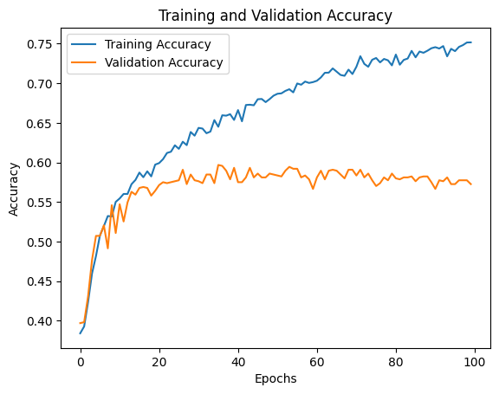
Visualization

Slide 25
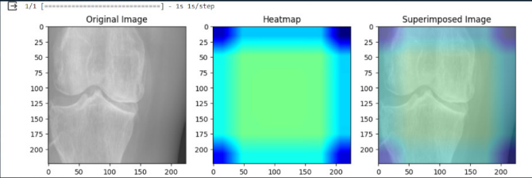
Provide us with information through the chart to identify the strengths and weaknesses of the project to work on
Heat map chart

Slide 26
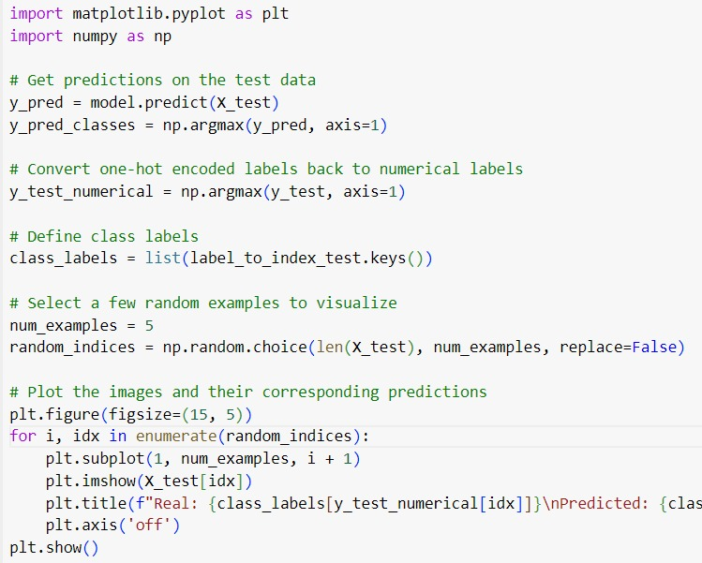
Process of prediction

Slide 27
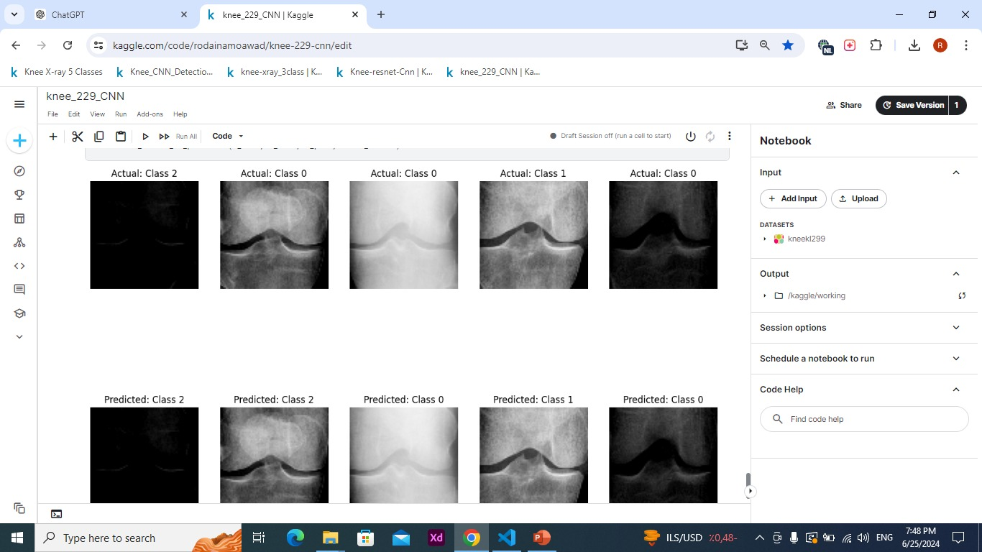
Result of prediction

Slide 28
Libraries we used
Libraries
OS library: to provide functions for interacting with the operating system.
NumPy: for working with arrays.
Matplotlib : for creating static, animated, and interactive visualizations
OpenCV: to perform tasks like detection, objection tracking.
Train - test: to divide datasets into training and testing subsets.
Image data generate: to augment images in real-time while model is still training.
Keras applications (vgg19 - mobilenet): pre-trained models to use them.
Adam optimizer: to minimize the loss function

Slide 29
The difficulties we faced
Throughout our journey, we encountered several challenges. Initially, the transfer learning models (resnet50, inception, and mobilenet,vgg16,vgg19) did not perform as expected, with low accuracy and precision. This was partly due to the specific nuances of medical imaging that these pre-trained models struggled to capture. Additionally, fine-tuning these models required extensive computational resources and time, which further complicated the processi in other hand Comparing between the models was also difficult and challenging
-Another significant difficulty was the preprocessing of images. While techniques like rotation, scaling, shearing, and adding grain were applied to enhance the training dataset, these augmentations did not sufficiently improve model performance
-balancing the training data to avoid overfitting and ensuring the model generalizes well to unseen data
-Lastly After consulting an orthopedic doctor, we learned that the factors influencing the diagnosis, such as age, age, medical history, and gender, will make a difference in evaluating the condition and its degree of difficulty, and this is not available to us.

Slide 30
Future work
Our future work for now is to enlarge our knowledge base more to achieve more steps in this field
And we must be concerned with collecting more accurate data to work with
But we do not deny the merit of the fact that we learned a lot from this trip and researched useful knowledge in many fields. We certainly aspired to do our best to discuss it with the esteemed committee.
And a big thank for DR. Ahmed EZZ and ENG.Ahmed Eisa for providing us with high informations and knowledge needed to be here helping people with a desease like that

Slide 31
THANK YOU

